Slide 1
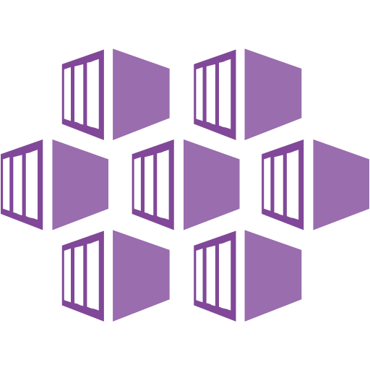
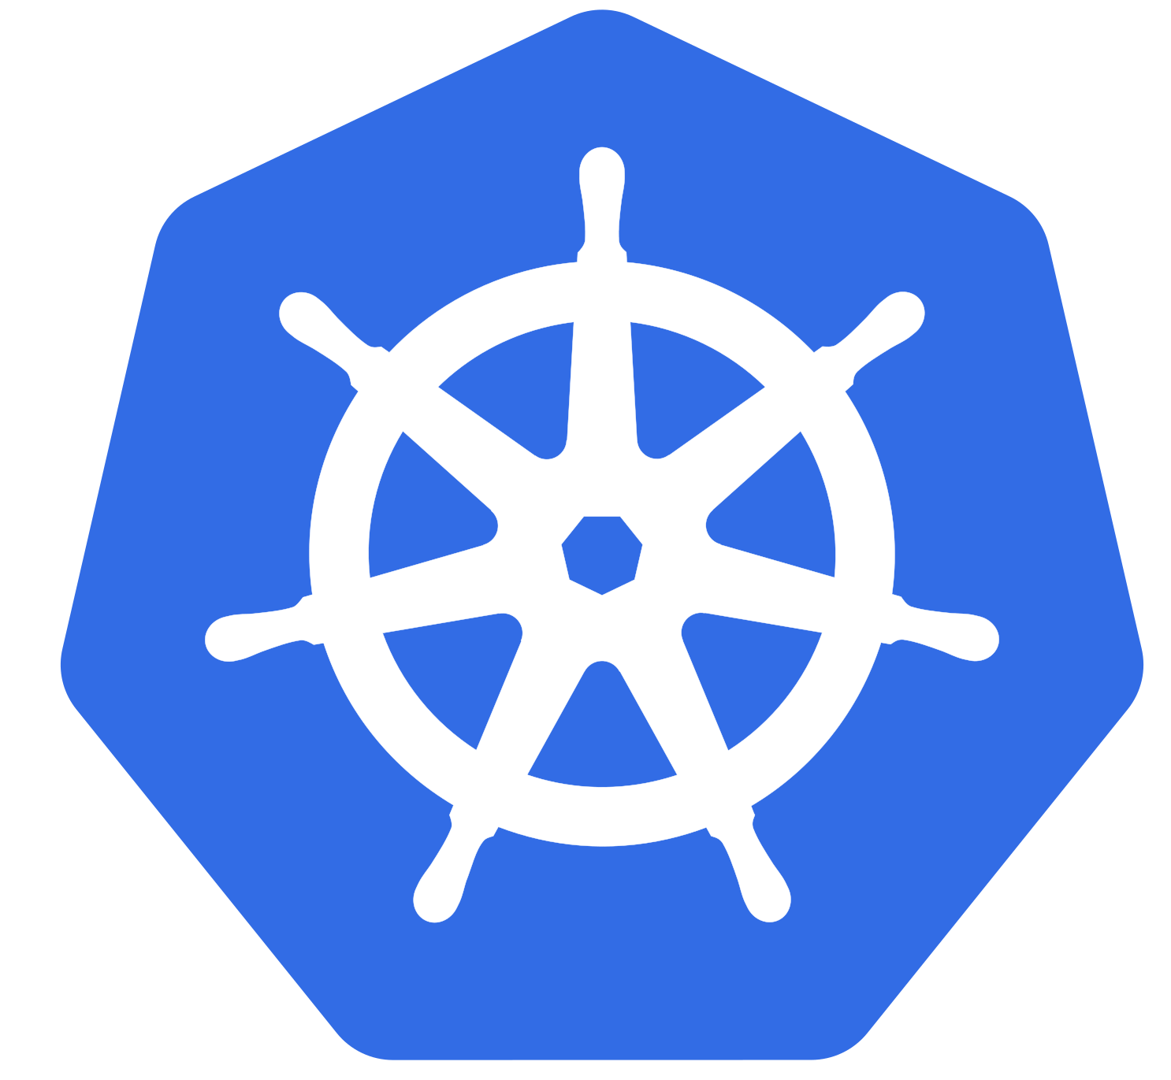
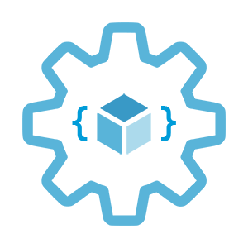

sysdm.cpl
Introduction to Azure Kubernetes Service (AKS)
Infrastructure as Code User Group Oslo
02.03.2021
Evgeny Borzenin

Slide 2
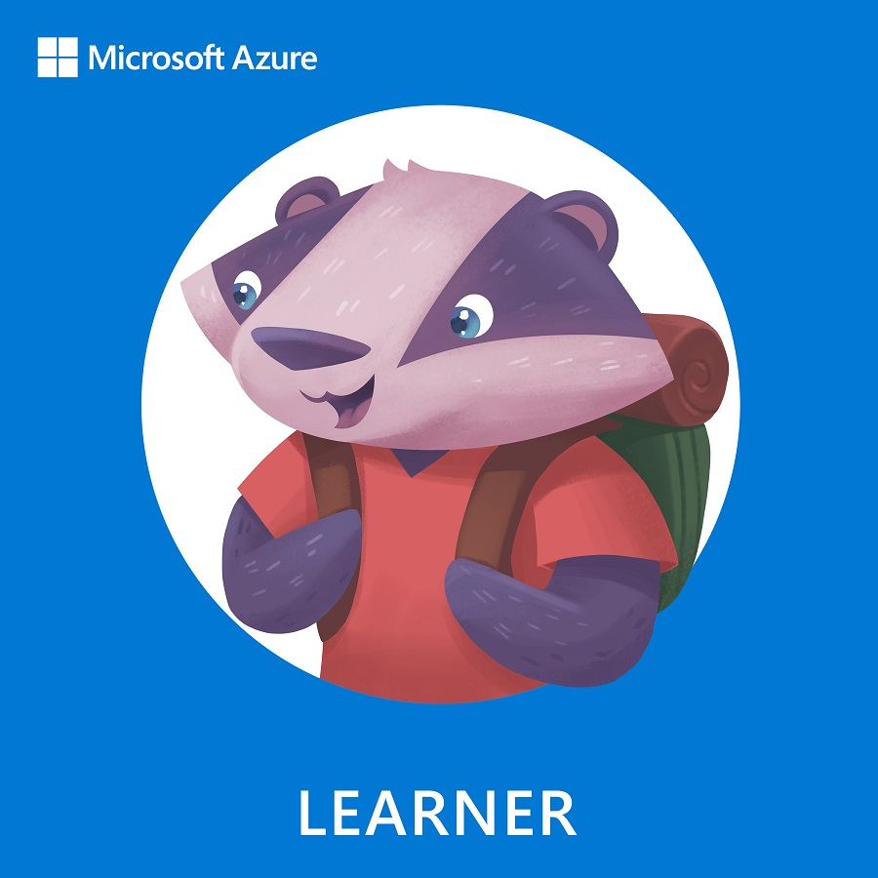
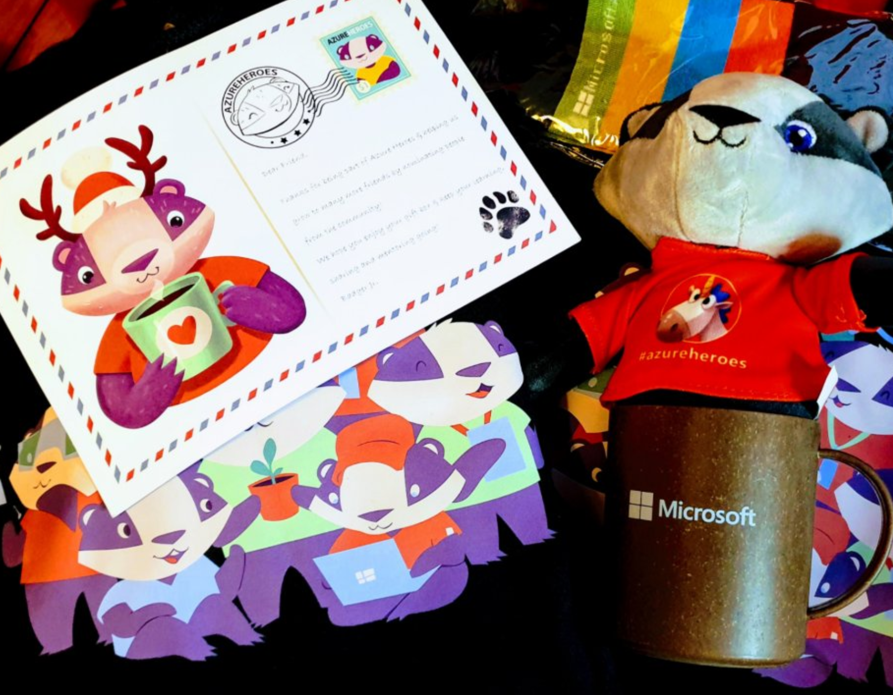
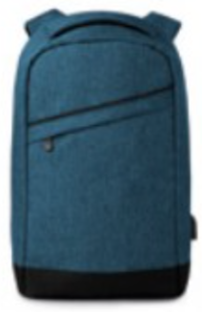


Learn more about VM on Azure https://aka.ms/azure-aks
Get your next Learner digital badge of Azure Heroes program https://aka.ms/azure-heroes-badge
Win a cool Microsoft backpack!
Don’t forget to add Microsoft Azure skill to your LinkedIn account to stay connected with a developer community
+ Microsoft Azure
We post the latest announces about free events for the developers in Norway on our official Twitter account
@MSDevNo
Notes:
* Our usergroup partners with Microsoft Norway and we have a cool Microsoft-branded backpack to share with today’s winner of the best tech question competition!
* On this slide you’ll find a link to the documentation about AKS, and a link to claim your digital badge of the Azure Heroes program. By the way, folks who collected the most badges received cool gift boxes recently. We’ll post these links into the chat window for your convenience.
* Also, Microsoft Norway has a tech twitter account where they announce their own and community-driven events for the developers – please follow @MSDevNo to stay updated.

Slide 3
Infrastructure as Code User Group 2021 roadmap
AKS workshops:
AKS and Kubernetes 101
Advanced AKS configuration (WIP – ETA end of March)
Service mesh with linkerd
Monitoring AKS cluster
AKS application deployment strategy
AKS security
Use Pulumi to provision and configure AKS cluster (???)

Slide 4
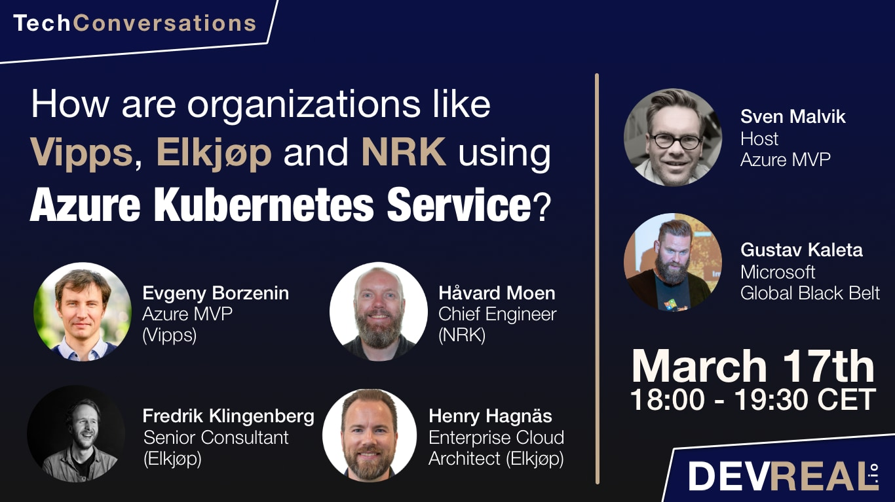

Slide 5
Infrastructure as Code User Group 2021 roadmap
“regular” events (work in progress)
GitOps vs Pulumi vs Terraform
+ work in progress
If you have any good AKS / Kubernetes / IaC story – welcome to share!

Slide 6
Practical information
Mix of slides and labs with focus on labs
I don’t have moderator
Let’s help each other, the one who finished earlier can help others
Keep the same resource names as in labs -> easier to troubleshot
Share your screen if you stack with something
Labs are available after the event

Slide 7
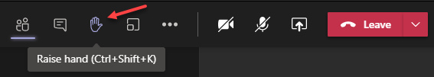
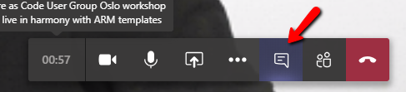
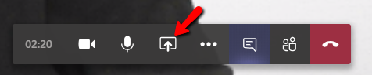
Microsoft Teams 101
Mute your mic (but don’t forget to unmute when you speak)
Feel free to use video
«Rise your hand» if you need some attention
Conversation/chat
If you want to have private discussion, find evgeny@enso.no and start chat with me
Share screen

Slide 8
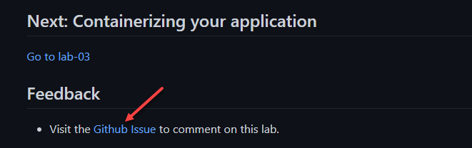
Practical information
Each lab is time-boxed
When you completed a lab, please post to the Conversation channel
lab-01 (lab-02, lab-03 etc…)
Labs will be available after the event
Feel free to contribute to the labs content by fixing gramma, typos, wrong commands etc..
Feel free to comment on each lab

Slide 9
Workshop agenda
Slides - Kubernetes and AKS introduction (10 min)
Lab-01 - AKS setup (15 min)
Lab-02 - setting up you shell for better AKS/kubectl experience (15 min)
Slides - Introduce our "guinea pig" app (10 min)
Lab-03 - Containerizing your application (15 min)
Pause
Slides - Pods, Namespaces (10 min)
Lab-04 - Creating, managing and testing pods (15 min)
Slides - Readiness and Liveness probes (15 min)
Lab-05 - Readiness and Liveness probes (15 min)
Slides - Deployments (5 min)
Lab-06 - Deployments (15 min)
Pause
Slides - Services, Labels, Selectors (10 min)
Lab-07 - Creating and Managing Services (15 min)
Slides - Configmaps and secrets (5 min)
Lab-08 - Configmaps and secrets (15 min)
Lab-09 - AKS Kubernetes resources at the Azure portal (15 min)
Lab-10 - Cleaning up (5 min)

Slide 10
Kubernetes and AKS introduction

Slide 11
What is Kubernetes (k8s)?
Kubernetes is a Container Management and Orchestration System and Cluster technology
Manage applications, not machines
Open source, open API container orchestrator
Inspired by Google’s experiences and internal systems
Greek for pilot or Helmsman – the person who steers a ship
Kubernetes -> k(ubernete)s -> len(ubernete) = 8 -> k8s
Notes:
Kubernetes is a portable, extensible open-source platform for managing and orchestrating containerized workloads.
Kubernetes abstracts away complex container management tasks and provides you with declarative configuration to orchestrate containers in different computing environments.
Container management is the process of organizing, adding, removing, or updating a significant number of containers.
A container orchestrator is a system that automatically deploys and manages containerized apps.
Kubernetes provides an open, pluggable API that can work with containers across multiple cloud providers.
Kubernetes is based on learnings from how Google itself has been running applications and containers, internally.
3 Google employee in 2014 and in production v1 in 2015
These learnings have given rise to new primitives, new ways of looking at orchestrating the cloud in order to abstract away the underlying machines. So that you can Manage applications, not machines

Slide 12
Kubernetes benefits
Self healing
Dynamic scaling
Rolling updates
Notes:
Self-healing of containers. An example would be restarting containers that fail or replacing containers.
Scaling deployed container count up or down dynamically, based on demand.
Automation of rolling updates and rollbacks of containers.
Management of storage.
Management of network traffic.
Storage and management of sensitive information, such as usernames and passwords.

Slide 13
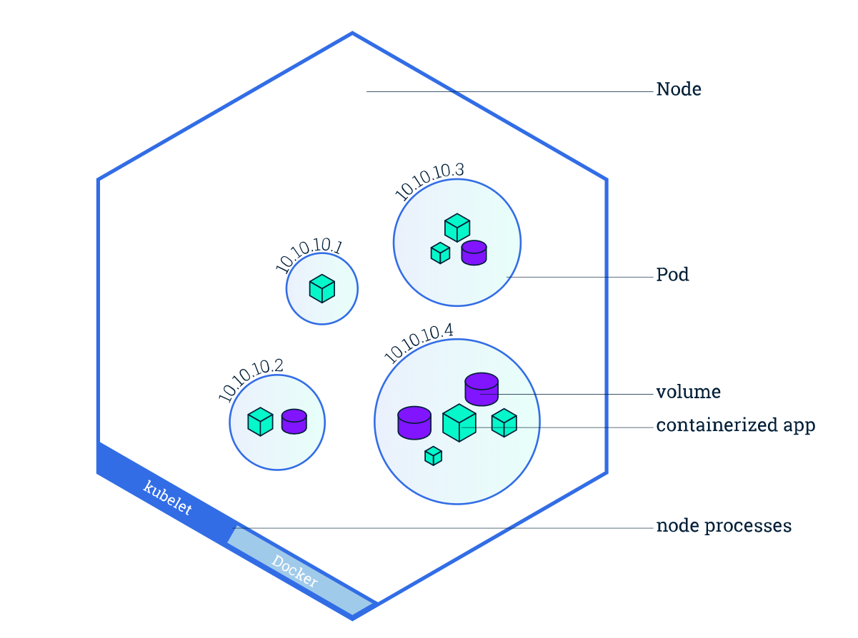
Kubernetes concepts
Cluster
Nodes
Pods
Desired state (Imperative vs. Declarative)
Deployments
Services
Image from https://kubernetes.io/docs/tutorials/kubernetes-basics/explore/explore-intro/

Slide 14
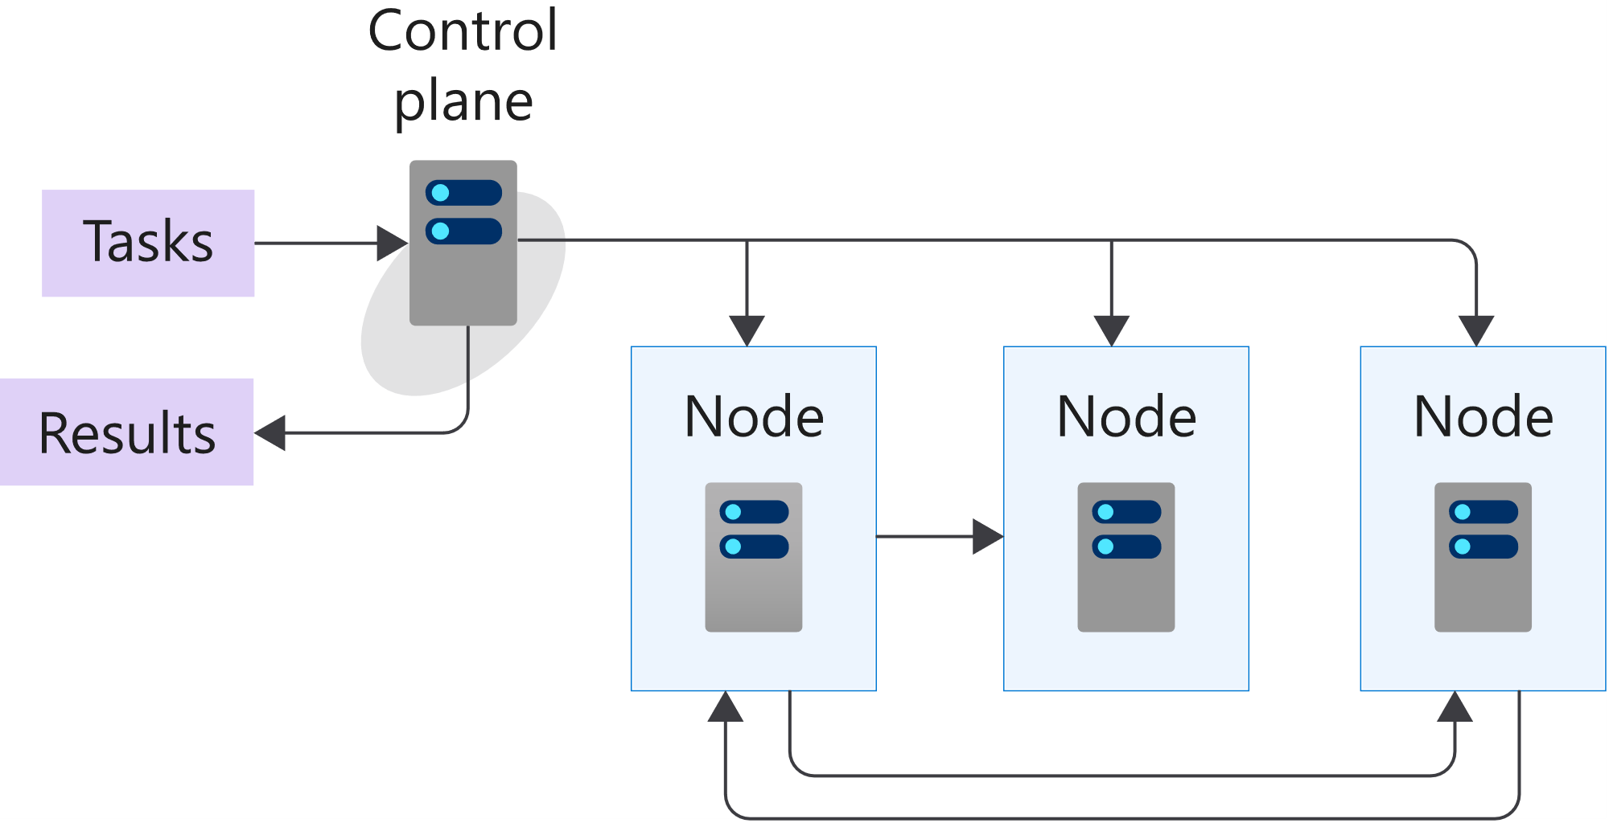
Kubernetes architecture
Image from https://docs.microsoft.com/en-us/learn/modules/intro-to-kubernetes/3-how-kubernetes-works
Notes:
A cluster is a set of computers that you configure to work together and view as a single system. The computers configured in the cluster will typically do different type of tasks. For example, they'll host websites, APIs, or run compute-intensive batches.
A cluster uses centralized software that's responsible for scheduling and controlling these tasks. The computers in a cluster that run the tasks are called nodes, and the computers that run the scheduling software are called control planes.

Slide 15
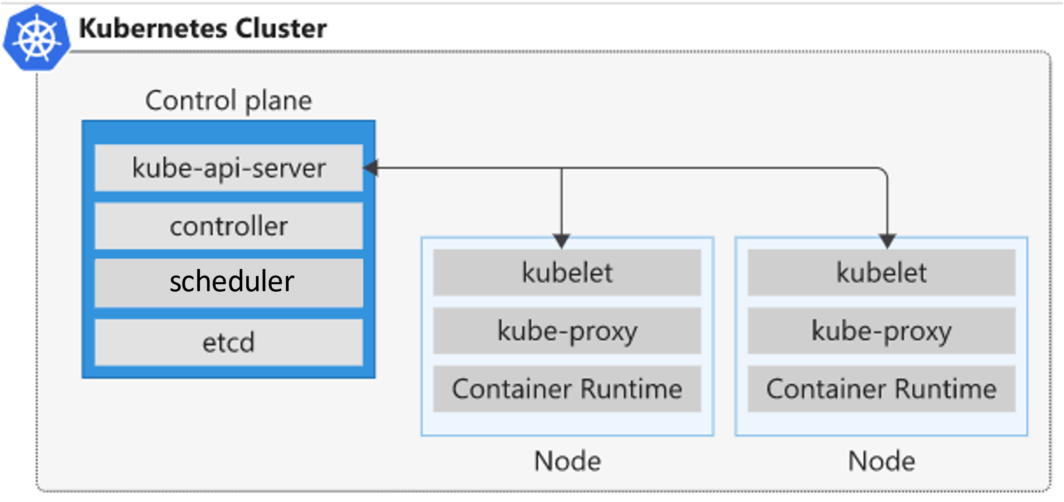
K8s 101: Nodes
Control plane node
API server
Backing store (etcd)
Scheduler
Controller manager
Node
Kubelet
Kube-proxy
Container runtime
Image from https://docs.microsoft.com/en-us/learn/modules/intro-to-kubernetes/3-how-kubernetes-works
Notes:
API server
You can think of the API server as the front end to the control plane in your Kubernetes cluster. All the communication between the components in Kubernetes is done through this API.
This component provides the interaction for management tools, such as kubectl
etcd - highly available, distributed, and reliable key/value store within Kubernetes
This key-value store stores the current state and the desired state of all objects within your cluster.
kube-scheduler - When you create or scale applications, the Scheduler determines what nodes can run the workload and starts them.
The scheduler is the component that's responsible for the assignment of workloads across all nodes. The scheduler monitors the cluster for newly created containers and assigns them to nodes.
kube-controller-manager - The Controller Manager oversees a number of smaller Controllers that perform actions such as replicating pods and handling node operations.
The controller communicates with the API server to determine the state of the object. If the current state is different from the wanted state of the object, then the controller will take action to ensure the wanted state.
Assume that one of three containers running in your cluster stops responding and has died. In this case, a controller decides whether you need to launch new containers to ensure that your apps are always available. If the desired state is to run three containers at any time, then a new container is scheduled to run.
kubelet
The kubelet is the agent that runs on each node in the cluster, and monitors work requests from the API server. It makes sure that the requested unit of work is running and healthy.
The kubelet monitors the nodes and makes sure that the containers scheduled on each node run, as expected.
kube-proxy
The kube-proxy component is responsible for local cluster networking and runs on each node. It ensures that each node has a unique IP address. It also implements rules to handle routing and load balancing of traffic by using iptables and IPVS.
container runtime
The container runtime is the underlying software that runs containers on a Kubernetes cluster. The runtime is responsible for fetching, starting, and stopping container images. Kubernetes supports several container runtimes, including but not limited to Docker, rkt, CRI-O, containerd, and frakti.

Slide 16

K8s 101: Nodes
Nodes are machines (VM) in your cluster
Nodes are where your workloads run
Nodes can come and go
Node1
Node2
Node3
Notes:
A node in a Kubernetes cluster is where your compute workloads run.
Each node communicates with the control plane via the API server to inform it about state changes on the node.

Slide 17
K8s 101: Pods
Pod is the smallest object that you can create
A single Pod can hold a group of one or more containers
Node1
Node2
Node3
pod
pod
pod
pod
app-a
app-b
app-b
app-a
app-d
Notes:
Unlike in a Docker environment, you can't run containers directly on Kubernetes.
You package the container into a Kubernetes object called a pod. A pod is the smallest object that you can create in Kubernetes.
A single pod can hold a group of one or more containers. However, a pod typically doesn't contain multiples of the same app.
You use pod templates to define the information about the pods that run in your cluster.
Pod templates are YAML-coded files
A pod includes information about the shared storage and network configuration, and a specification about how to run its packaged containers.

Slide 18
K8s 101: Desired State
Imperative vs. Declarative - tell Kubernetes what you want, not what to do
Kubernetes always tries to steer the cluster to its desired state
You: “Hey, k8s, I want 3 replicas of app-a”
K8s: “Here are 3 replicas of app-a”
K8s: “Upps, one just died, I will try to find a node where I can spin up a new replica”
K8s: “Here are 3 replicas of app-a”
Notes:
(Imperative vs. Declarative)
One of the core concepts of Kubernetes - Desired State. Tell Kubernetes what you want, not what to do.

Slide 19
K8s 101: Deployment
Pod templates
Replica Sets
Deployments
Notes:
There are several options to manage the deployment of pods in a Kubernetes cluster
A pod template enables you to define the configuration of the pod you want to deploy.
The template contains information, such as the name of container image, and which container registry to use to fetch the images.
The template may also include runtime configuration information, such as ports to use.
Templates are defined by using YAML.
You can use templates to deploy pods manually. However, a manually-deployed pod isn't relaunched after it fails, is deleted, or is terminated.
To manage the lifecycle of a pod, you need to create a higher-level Kubernetes object.
A replica set uses pod templates and defines a specified number of pods that must run
A deployment creates a management object one level higher than a replica set and enables you to deploy and manage updates for pods in a cluster.

Slide 20
K8s 101: Deployment
Deployments are requirements you give to Kubernetes regarding your applications (Pods)
k8s: I need 2 replicas of app-a and 3 replicas of app-b
Node1
Node2
Node3
pod
pod
pod
pod
pod
app-a
app-b
app-b
app-a
app-b

Slide 21
K8s 101: Services
Service is an abstract way to expose an application running on a set of Pods
A Service has a name and maps to a dynamic set of Pods defined by a label selector
service-a
service-b
Node1
Node2
Node3
pod
pod
pod
pod
pod
app-a
app-b
app-b
app-a
app-b
Notes:
A Kubernetes service is a Kubernetes object that provides stable networking for pods. A Kubernetes service enables communication between nodes, pods, and users of your app, both internal and external, to the cluster.

Slide 22

Azure Kubernetes Service (AKS)
+
=
Notes:
Azure Kubernetes Service (AKS) is a managed Kubernetes offering that simplifies container-based application deployment and management.
Azure Kubernetes Service (AKS) provides a managed Kubernetes service that reduces the complexity for deployment and core management tasks, including coordinating upgrades.

Slide 23
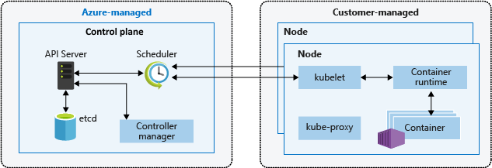
AKS cluster architecture
Image from https://docs.microsoft.com/en-us/azure/aks/concepts-clusters-workloads
Notes:
The AKS control plane is managed by the Azure platform, and you only pay for the AKS nodes that run your applications. AKS is built on top of the open-source Azure Kubernetes Service Engine (aks-engine).
When you create an AKS cluster, a control plane is automatically created and configured. This control plane is provided as a managed Azure resource abstracted from the user. There's no cost for the control plane, only the nodes that are part of the AKS cluster.
API server
You can think of the API server as the front end to the control plane in your Kubernetes cluster. All the communication between the components in Kubernetes is done through this API.
This component provides the interaction for management tools, such as kubectl or the Kubernetes dashboard.
etcd - highly available, distributed, and reliable key/value store within Kubernetes
The backing store is a persistence store that your Kubernetes cluster uses to save the complete configuration of a Kubernetes cluster
This key-value store stores the current state and the desired state of all objects within your cluster.
kube-scheduler - When you create or scale applications, the Scheduler determines what nodes can run the workload and starts them.
The scheduler is the component that's responsible for the assignment of workloads across all nodes. The scheduler monitors the cluster for newly created containers and assigns them to nodes.
kube-controller-manager - The Controller Manager oversees a number of smaller Controllers that perform actions such as replicating pods and handling node operations.
The controller communicates with the API server to determine the state of the object. If the current state is different from the wanted state of the object, then the controller will take action to ensure the wanted state.
Assume that one of three containers running in your cluster stops responding and has died. In this case, a controller decides whether you need to launch new containers to ensure that your apps are always available. If the desired state is to run three containers at any time, then a new container is scheduled to run.

Slide 24
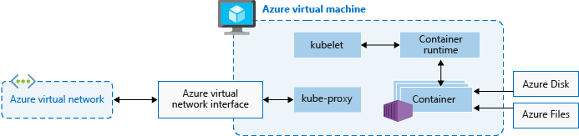
AKS nodes
Image from https://docs.microsoft.com/en-us/azure/aks/concepts-clusters-workloads
Notes:
To run your applications and supporting services, you need a Kubernetes node. An AKS cluster has one or more nodes, which is an Azure virtual machine (VM) that runs the Kubernetes node components and container runtime.
The kubelet is the Kubernetes agent that processes the orchestration requests from the control plane and scheduling of running the requested containers.
Virtual networking is handled by the kube-proxy on each node. The proxy routes network traffic and manages IP addressing for services and pods.
The container runtime is the component that allows containerized applications to run and interact with additional resources such as the virtual network and storage.

Slide 25
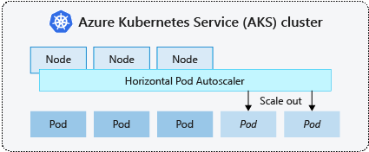
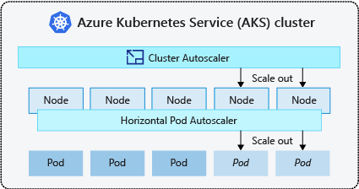
AKS scaling options
Manually scale pods or nodes
Horizontal pod autoscaler
KEDA
Cluster autoscaler
https://docs.microsoft.com/en-us/azure/aks/concepts-scale

Slide 26

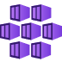




AKS scaling options
AKS
docker push
docker pull
ACR
Virtual Network
Resource Group
Log Analytics
Monitor

Slide 27
Lab-01, 02, 03

Slide 28
Pause

Slide 29
k8s 101: Pods

Slide 30
Pods
A Pod is an abstraction that represents:
a group of one or more application containers
Shared storage, as Volumes
Networking, as a unique cluster IP address
Information about image version and specific ports to use
10.240.0.3
pod
app-a
app-b
Config
map
Secrets
Notes:
A pod represents a single instance of an app running in Kubernetes. The workloads that you run on Kubernetes are containerized apps. Unlike in a Docker environment, you can't run containers directly on Kubernetes. You package the container into a Kubernetes object called a pod. A pod is the smallest object that you can create in Kubernetes.
A single pod can hold a group of one or more containers. However, a pod typically doesn't contain multiples of the same app.
A pod includes information about the shared storage and network configuration, and a specification about how to run its packaged containers. You use pod templates to define the information about the pods that run in your cluster. Pod templates are YAML-coded files that you reuse and include in other objects to manage pod deployments.

Slide 31
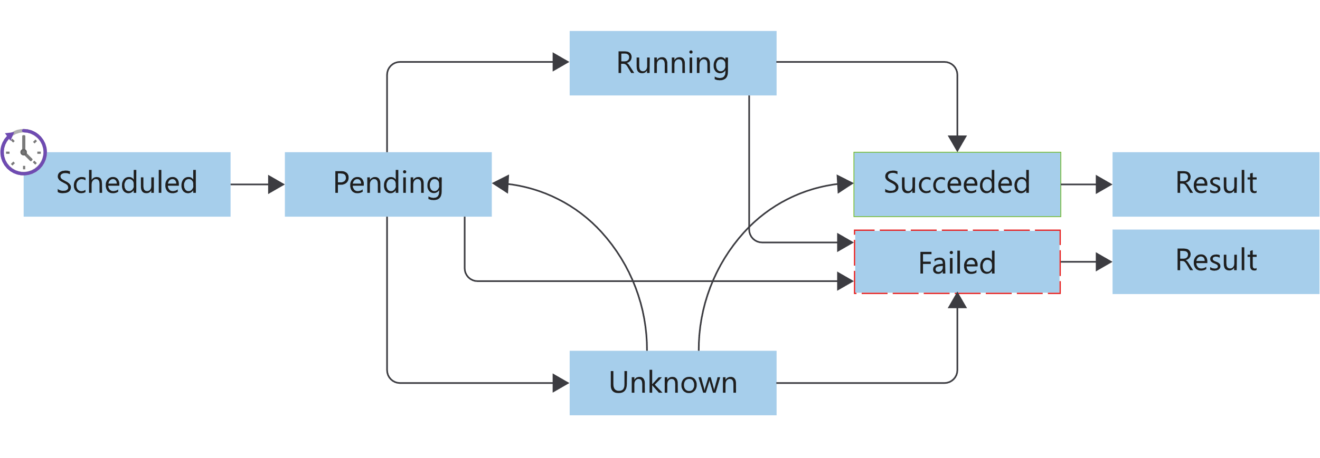
Pods lifecycle
Image from https://docs.microsoft.com/en-us/learn/modules/intro-to-kubernetes/3-how-kubernetes-works
Notes:
Kubernetes pods have a distinct lifecycle that affects the way you deploy, run, and update pods. You start by submitting the pod YAML manifest to the cluster. After the manifest file is submitted and persisted to the cluster, it defines the desired state of the pod. The scheduler schedules the pod to a healthy node that has enough resources to run the pod.
Pending
After the pod run is scheduled, the container runtime downloads container images, and starts all containers for the pod.
Running
The pod transitions to a running state after all of the resources within the pod are ready.
Succeeded
The pod transitions to a succeeded state after the pod completes its intended task, and runs successfully.
Failed
Pods can fail for various reasons. A container in the pod may have failed, leading to the termination of all other containers. Or, maybe an image wasn't found during preparation of the pod containers. In these types of cases, the pod can go to a failed state. Pods can transition to a failed state from either a pending state or a running state. A specific failure can also place a pod back in the pending state.
Unknown
If the state of the pod can't be determined, the pod is an unknown state.

Slide 32
Lab-04

Slide 33
k8s 101: Readiness and Liveness probes

Slide 34
Liveness probe
On every node is a daemon called a Kubelet
One of the Kubelet’s jobs is to ensure that pods are healthy
Kubelet sends out a liveness probe to a pod
app-a, are you alive?
No
Node
kubelet
pod
app-a

Slide 35
Liveness probe
If the Kubelet gets back multiple bad responses
app-a, restart!
Node
kubelet
pod
app-a

Slide 36
Liveness probe
This cycle then starts all over again
app-a, are you alive?
Yes!
Node
kubelet
pod
app-a

Slide 37
Readiness probe
app-a is already alive
kubelet sends readiness probe
If app-a is not ready, wait and send new request
service-a
app-a, are you ready?
Node
kubelet
pod
pod
pod
app-a
app-a
app-a
Not yet

Slide 38
Readiness probe
This cycle then starts all over again
Send traffic to app-a
service-a
app-a, are you ready?
Node
kubelet
pod
pod
pod
app-a
app-a
app-a
Yes!

Slide 39
Lab-05

Slide 40
k8s 101: Deployments

Slide 41
Deployments
Drive current state towards desired state
app: app-a
replicas: 3
app: app-a
replicas: 1
Node1
Node2
Node3
Node3
pod
pod
pod
pod
app-a
app-a
app-a
app-a

Slide 42
Rolling Update
service-a
Node1
Node1
Node1
pod
pod
pod
pod
app-a: v1
app-a: v1
app-a: v1
app-a: v2

Slide 43
Rolling Update
service-a
Node1
Node1
Node1
pod
pod
pod
pod
app-a: v1
app-a: v1
app-a: v1
app-a: v2

Slide 44
Rolling Update
service-a
Node1
Node1
Node1
pod
pod
pod
pod
app-a: v1
app-a: v2
app-a: v1
app-a: v2

Slide 45
Rolling Update
service-a
Node1
Node1
Node1
pod
pod
pod
pod
app-a: v1
app-a: v2
app-a: v1
app-a: v2

Slide 46
Rolling Update
service-a
Node1
Node1
Node1
pod
pod
pod
pod
app-a: v2
app-a: v1
app-a: v2
app-a: v2

Slide 47
Rolling Update
service-a
Node1
Node1
Node1
pod
pod
pod
pod
app-a: v2
app-a: v1
app-a: v2
app-a: v2

Slide 48
Rolling Update
service-a
Node1
Node1
Node1
pod
pod
pod
app-a: v2
app-a: v2
app-a: v2

Slide 49
Lab-06

Slide 50
Pause

Slide 51
k8s 101: Services, Labels, Selectors

Slide 52
Services
Persistent Endpoint for Pods
Use Labels and Selectors to select Pods
service-a
pod
pod
pod
app-a
app-a
app-a
labels:
app: app-a
labels:
app: app-a
labels:
app: app-a
Notes:
A Kubernetes service is a Kubernetes object that provides stable networking for pods. A Kubernetes service enables communication between nodes, pods, and users of your app, both internal and external, to the cluster.
Kubernetes assigns a service an IP address on creation, just like a node or pod. These addresses get assigned from a service cluster's IP range. An example is 10.96.0.0/12. A service is also assigned a DNS name based on the service name, and an IP port.
Managing pods by IP address isn't practical. Pod IP addresses change as controllers re-create them, and you might have any number of pods running.

Slide 53
Labels and selector
selector:
app: app-a
pod
pod
pod
app-a
app-a
app-a
labels:
app: app-a
version: v1
labels:
app: app-a
version: v1
labels:
app: app-a
version: v2
Notes:
A service object enables you to target and manage specific pods in your cluster by using selector labels. You set the selector label in a service definition to match the pod label defined in the pod's definition file.

Slide 54
Labels and selector
selector:
app: app-a
version: v1
pod
pod
pod
app-a
app-a
app-a
labels:
app: app-a
version: v1
labels:
app: app-a
version: v1
labels:
app: app-a
version: v2

Slide 55
Lab-07

Slide 56
k8s 101: Configmaps and secrets
Notes:
We don’t want to hard code sensitive credentials directly into our code or configuration.
Secrets allow you to mount sensitive data as either a file in a volume, or directly into environment variables. The next few slides animates how it works in k8s. The same applicable for ConfigMaps

Slide 57
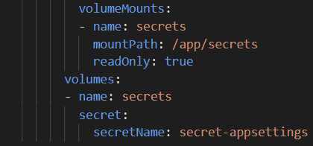
Secrets and ConfigMaps
kubectl create secret / kubectl cerate cm
Node
10.240.0.3
pod
kubelet
app-a
/app/secrets
secret
Notes:
Kubernetes uses the same storage volume concept that you find when using Docker. Docker volumes are less managed than the Kubernetes volumes because Docker volume lifetimes aren't managed. The Kubernetes volume's lifetime is an explicit lifetime that matches the pod's lifetime. This lifetime match means a volume outlives the containers that run in the pod. However, if the pod is removed, so is the volume.

Slide 58
Lab-08, 09

